Slide 1


TIC-TAC-TOE
Mazin AlRahbi
Professor: Dr. Mirzaei Shahnam
ECE 524
California State University Northridge

Slide 2
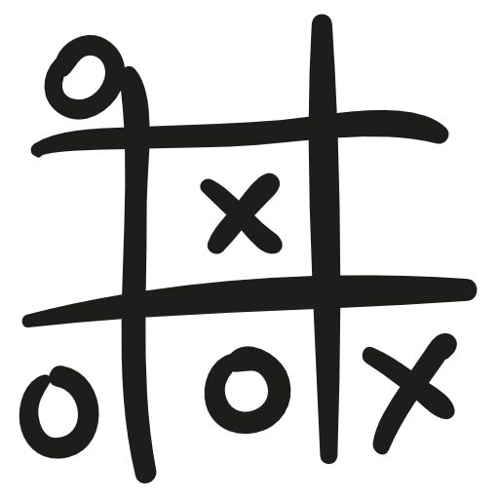
Contents
Introduction
Problem Statement
Finite State Machine
Winning conditions
FPGA Utilization
Results
Challenges

Slide 3
What is tic tac toe?
Played by two people.
three-by-three, two-dimensional grid.
Three marks on a row either in a horizontal, vertical, or diagonal direction.

Slide 4
Introduction
Implements a tic-tac-toe game on FPGA using Verilog
Use buttons to take input from the user
Use LEDs to represent the choice of the users.
Internal state machine to check input and declare result
Reset the game anytime.

Slide 5

Problem Statement
Develop a self-contained tic-tac-toe game
Game should be playable between two users
Should have following mechanisms:
Error Checking
Button to reset game at any point
Validation of turns against winning combinations
Indication of current turn
Indication of winner

Slide 6
Finite State Machine
IDLE
Wait for start_game signal
start new game
PLAYER_TURN
Validate input
validation passed
wait for user input
ASSERT_LED
Toggle turn signal
Assert relevant LED
Proceed to check winner
start new game
ASSERT_ERR
Maintain turn
Assert Error signal
validation failed
Proceed to wait for user input
CHECK_WINNER
Check context against winning combinations
Winner detected
No winner detected
DEC_WINNER
Assert relevant winner signal
Proceed to wait for new game to start

Slide 7
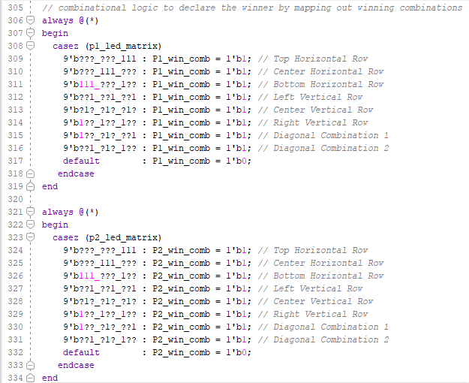
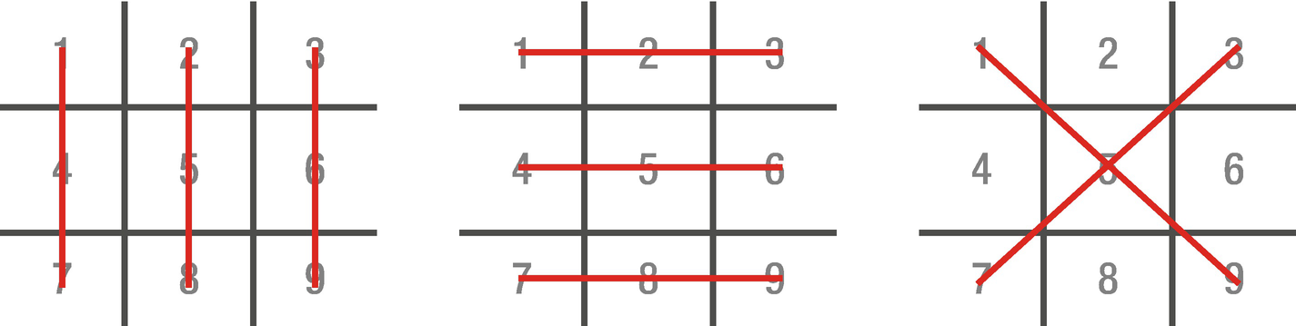
Winning conditions
Notes:
Tic tac toe has 8 possible winning conditions which are shown in the figure to the right,

Slide 8
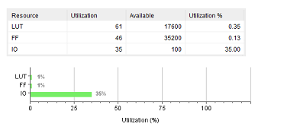
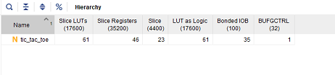
FPGA Utilization

Slide 9
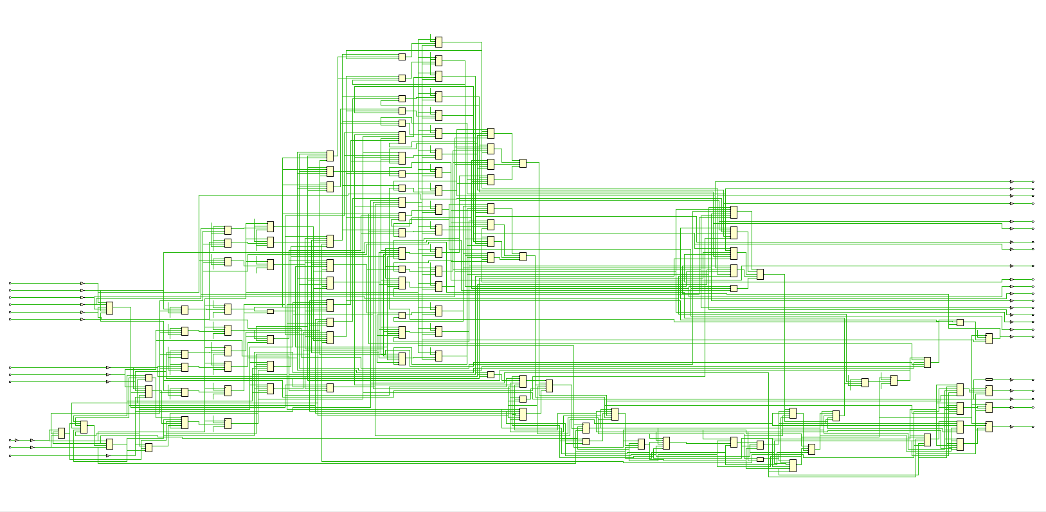
Synthesized Schematic

Slide 10
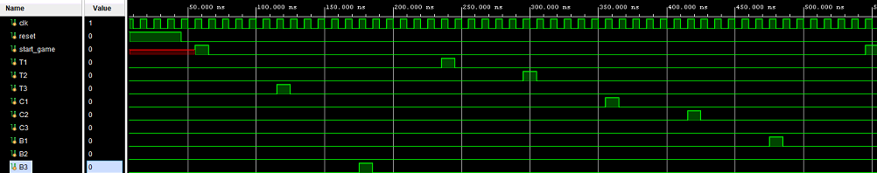
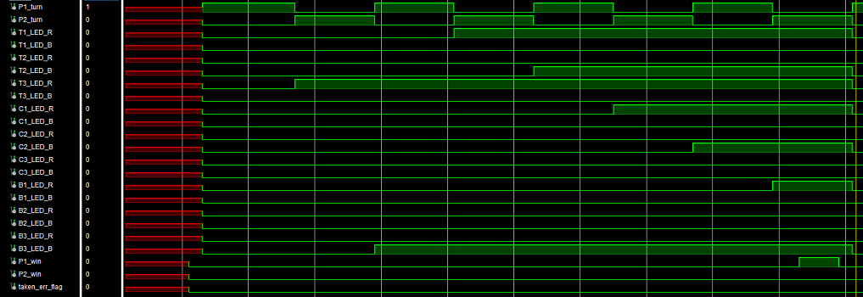
Results: player 1 wins case
Input Signals
Output Signals

Slide 11
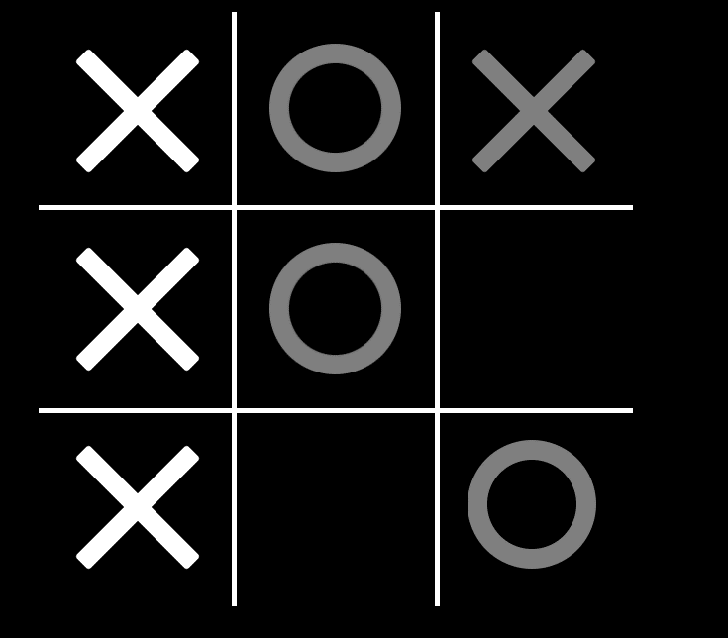
PLAYER 1 WIN CASE ILLUSTRATION

Slide 12
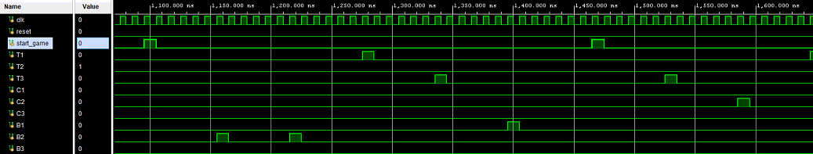
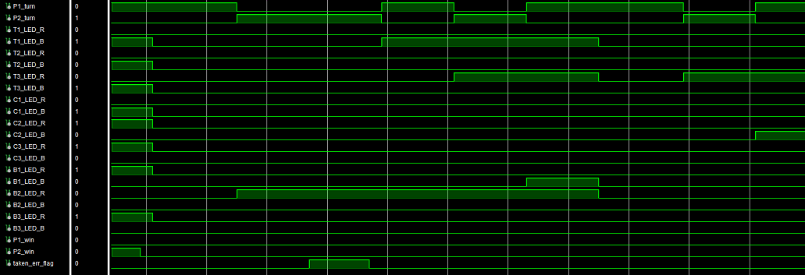
Results: ERROR FLAG / RESET
Input Signals
Output Signals

Slide 13
Challenges
Thinking from the point-of-view of the user
Usage of casez structure for specialized condition

Slide 14
Thanks for listening!

